Slide 1

Real drinking-water quality in Germany
Real drinking-water quality in Germany
Heba Alqassab
Wadeea Almutawa
Sayed Ali Alawi
Your life deserves a pure water
DAB-16

Slide 2


Introduction
TFW public supplier in Germany
several challenges in water quality changes
Provision of essential tasks for water supply companies
TFW idea to beat the competitors
Challenges encourage robust modeling of Senser Dehavior

Slide 3

PROBLEM STATEMENT
Between August and November 2016, sensor data from a water distribution system in Germany indicated 1726 anomalies events. Which may reflect a contamination risk, a sensor malfunction, or a chemical imbalance.
APPROACH
How does the system detect anomalies?
How does the flowrate (sensors 1 and 2) vary over time?
Do chlorine dioxide (ClO2) levels show consistent readings?
How does redox potential change over time?
Are pH values within the safe range?
How do the parameters affect each other?

Slide 4

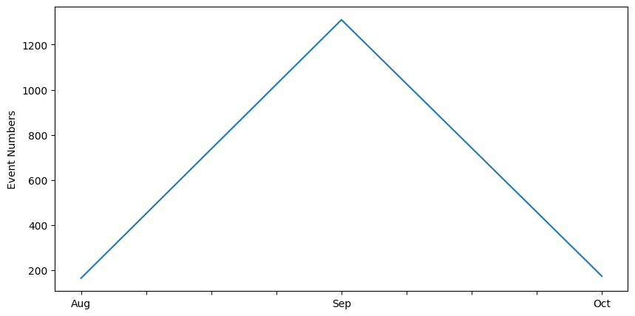
How does the system detect anomalies?

Slide 5
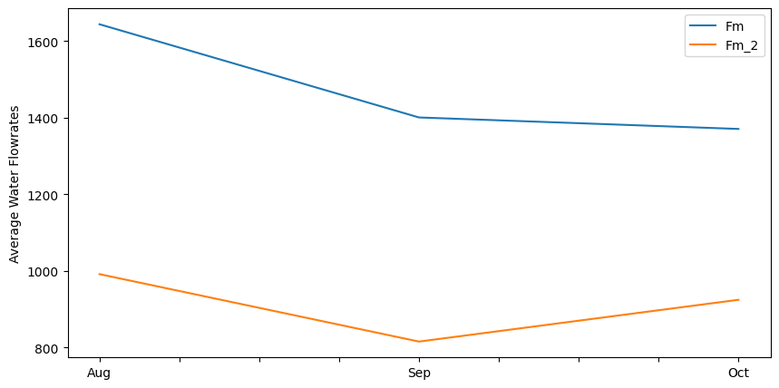
How does the flowrate (sensors 1 and 2) vary over time?

Slide 6
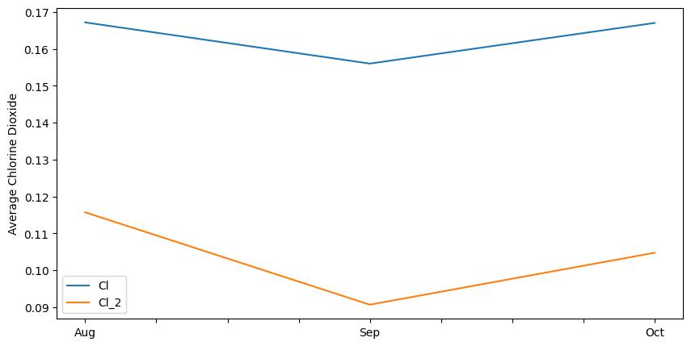
Do chlorine dioxide (ClO2) levels show consistent readings?

Slide 7
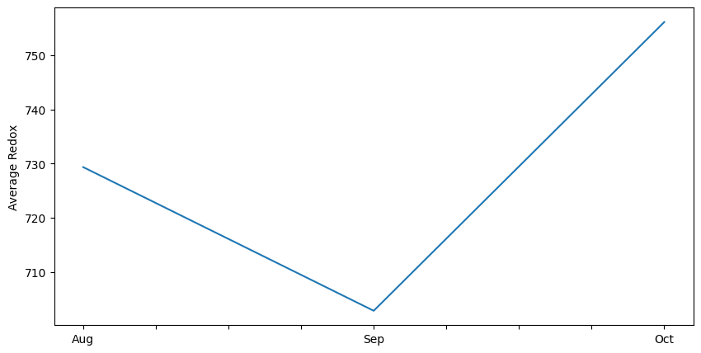
How does redox potential change over time?

Slide 8
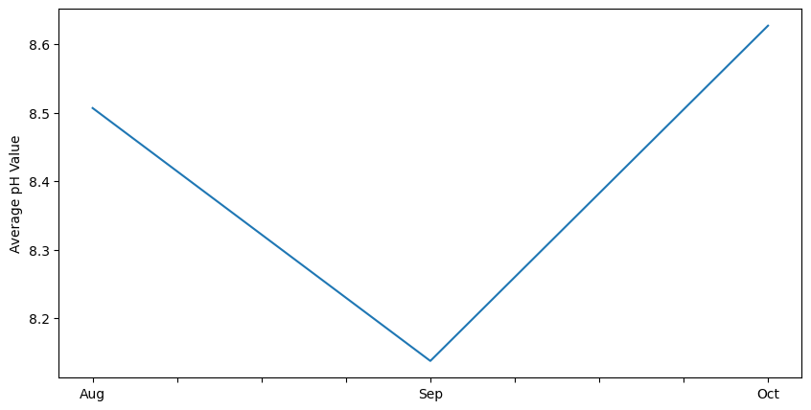
Are pH values within the safe range?

Slide 9
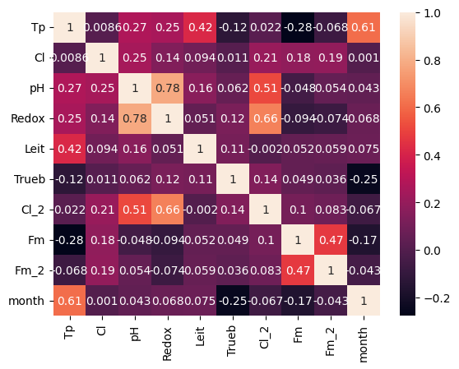

How do the parameters affect each other?

Slide 10

Conclusion
1.
Sensor system work effectively
2.
pH is in the safe range
3.
Water quality meets drinking standers

Slide 11
Recommendations
1.
Standardize sensor 2
Add more measurements (minerals content)
2.
3.
Include water source

Slide 12
Thank You!
!uoY knahT

